Slide 1
ComboBox Control
Prof. Neeraj Bhargava
Kapil Chauhan
Department of Computer Science
School of Engineering & Systems Sciences
MDS University, Ajmer

Slide 2
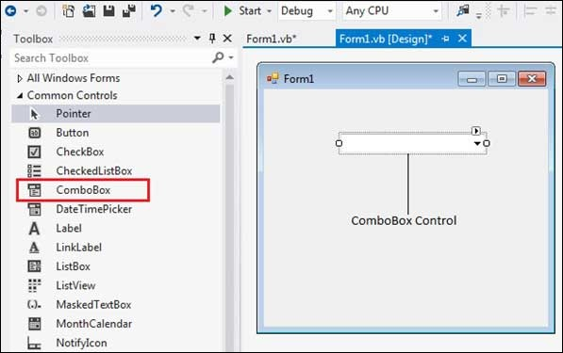
VB.Net - ComboBox Control

Slide 3
ComboBox Control
The ComboBox control is used to display a drop-down list of various items.
It is a combination of a text box in which the user enters an item and a drop-down list from which the user selects an item.

Slide 4
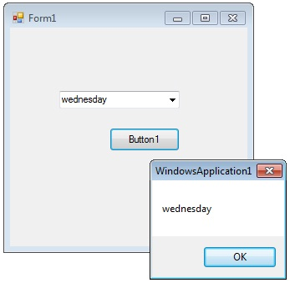
The ComboBox control is used to display a drop-down list of various items.
It is a combination of a text box in which the user enters an item and a drop-down list from which the user selects an item.

Slide 5
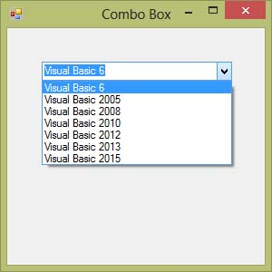
The user can type a value in the text field or click the button to display a drop down list.
In addition to display and selection functionality, the ComboBox also provides features that enable you to efficiently add items to the ComboBox.

Slide 6
Properties of the ComboBox Control
Sr.No. | Property & Description
1 | AllowSelection Gets a value indicating whether the list enables selection of list items.
2 | AutoCompleteMode Gets or sets an option that controls how automatic completion works for the ComboBox.
3 | DataManager Gets the CurrencyManager associated with this control.
4 | DataBindings Gets the data bindings for the control

Slide 7
5 | DataSource Gets or sets the data source for this ComboBox.
6 | DropDownStyle Gets or sets a value specifying the style of the combo box.
7 | DropDownWidth Gets or sets the width of the of the drop-down portion of a combo box.
8 | FlatStyle Gets or sets the appearance of the ComboBox.
9 | ItemHeight Gets or sets the height of an item in the combo box.
10 | SelectedItem Gets or sets currently selected item in the ComboBox.

Slide 8
Methods of the ComboBox Control
5DataSource
Gets or sets the data source for this ComboBox.
6DropDownStyle
Gets or sets a value specifying the style of the combo box.
7DropDownWidth
Gets or sets the width of the of the drop-down portion of a combo box.
8FlatStyle
Gets or sets the appearance of the ComboBox.
9ItemHeight
Gets or sets the height of an item in the combo box.
10SelectedItem
Gets or sets currently selected item in the ComboBox.

Slide 9
Assignment
Explain combobox in vb.net with suitable example and discuss the following terms regarding combobox.
(i) properties
(ii)methods
(iii) event

